Slide 1


Performance matrix
Linear regression.

Slide 2
Performance matrix:
To check the performance of a linear regression model, we use performance matrix.
Two types:
R-Square
Adjusted R square

Slide 3
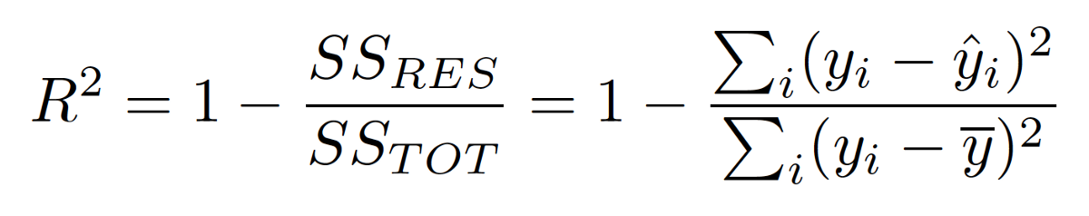
R-square

Slide 4
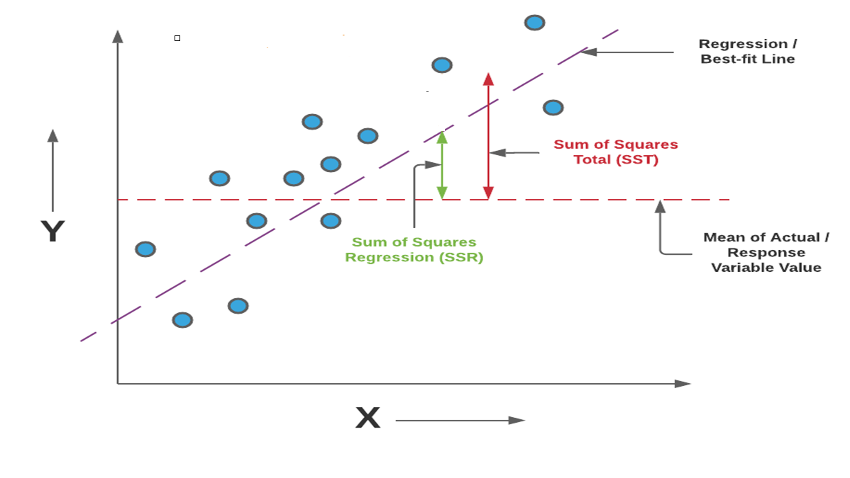

Slide 5
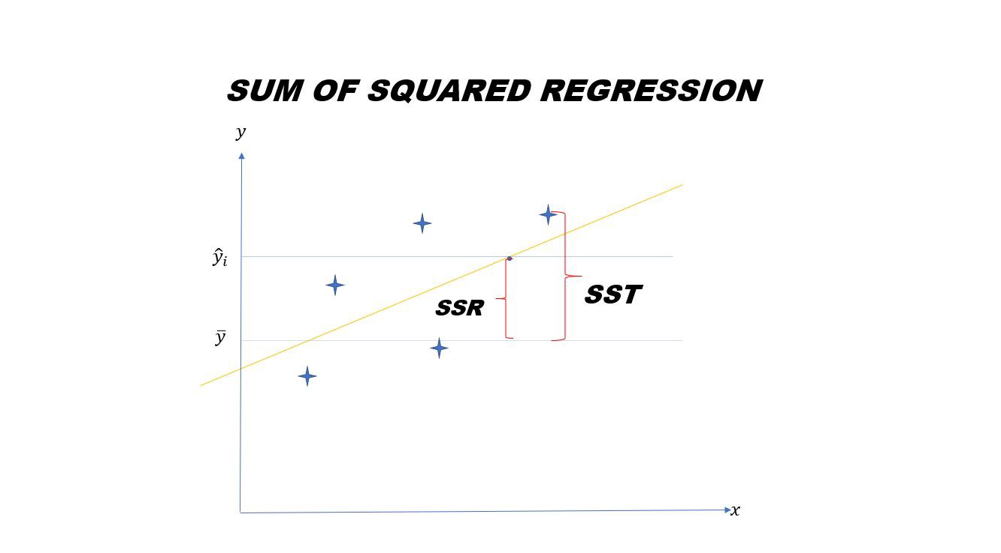
Which distance will be high?
Numerator or denominator?
The denominator will be high.
The reason is the mean difference will be higher.
So the overall (1-small number)=+ve number
That means our model has fitted properly.

Slide 6
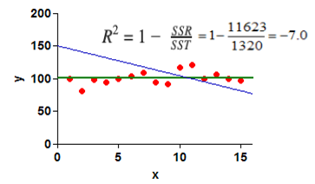
Can I get R-Square as negative number?
When SS(RES)>SS(TOT)
So, our aim is to get a best fit line which is not worst than the average line.

Slide 7
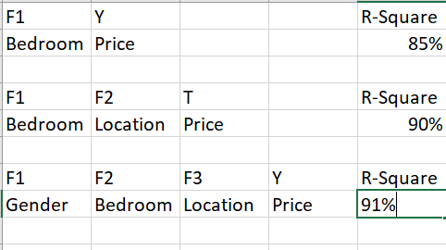
Suppose there is a table:
Here in 1st case, F1 and Y is corelated.
In 2nd case, it is also corelated.
But in 3rd case, F1 is not corelated to Y. Still R-square is giving good value.

Slide 8
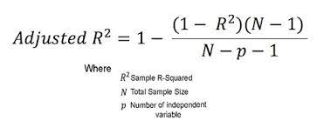
So, what is the solution?
To save the model we have to use another performance matrix, i.e Adjusted R square.

Slide 9
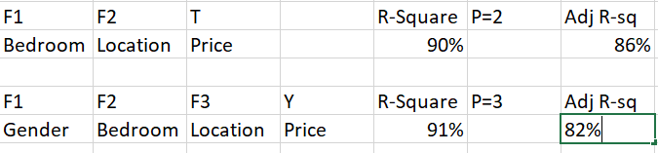
How it works?

Slide 10
Why the values decreased?
If P keeps increasing, the denominator will keep decreasing
So the fraction will be a bigger number.
(P=2)>Adj R-Square>>(P=3)
So, P is inversely proportional to Adj R-Square.

